Slide 1
Risk Management
University of Stirling Luca Novellis

Slide 2
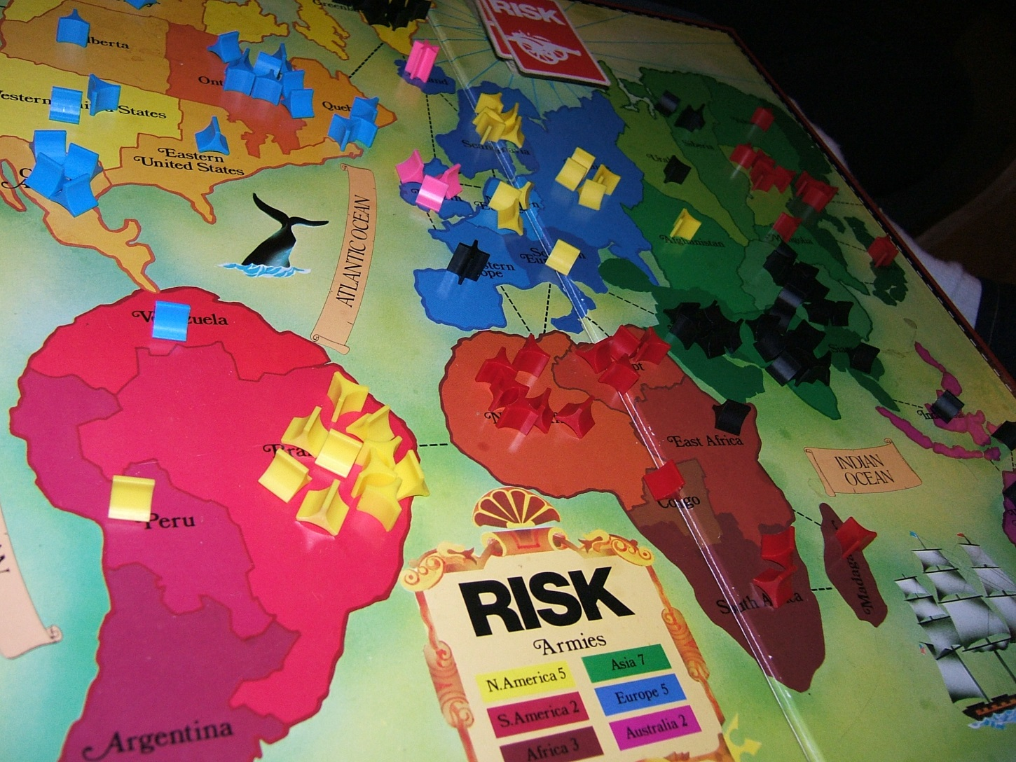
This is another kind of Risk

Slide 3
Definition of Risk
Risk is the possibility that something unpleasant or unwelcome will happen (Oxford Dictionary)

Slide 4
Definition of Risk
Risk is the possibility that something unpleasant or unwelcome will happen (Oxford Dictionary)
Something may or may not happen.
We are dealing with uncertain events.

Slide 5
Definition of Risk
Risk is the possibility that something unpleasant or unwelcome will happen (Oxford Dictionary)
It is a situation involving exposure to damage of any kind (e.g. financial loss, physical injury, …).

Slide 6
Definition of Risk
Risk is the possibility that something unpleasant or unwelcome will happen (Oxford Dictionary)
It is related to the future.

Slide 7

Example of Risk
Environmental: wildlife smuggling may cause the introduction of invasive and harmful species into an ecosystem, which can endanger indigenous wildlife.

Slide 8
Example of Risk
Security : while using your credit card online your information can be stolen if you are buying on unreliable websites, using an infected pc, not using a secure connection or using a secure connection unaware of its bugs.
Bad news. A major vulnerability, known as “Heartbleed,” has been disclosed for the technology that powers encryption across the majority of the internet.

Slide 9
Example of Risk
Software: in computer science a common risk can be a schedule slip or a cost overrun. The loss is often considered in terms of direct financial loss, but also can be a loss in terms of credibility and future business.

Slide 10
Why is the software world interested in risk?
One of the main reasons is the cost factor. Mitigate events that might adversely impact a project can reduce the amount of money spent on it.
“The software industry is fraught with failed and delayed projects, most of which far exceed their original budget.” (Standish Group)

Slide 11
Why is the software world interested in risk?
“A project post-mortem is a process, usually performed at the conclusion of a project, to determine and analyse elements of the project that were successful or unsuccessful. Project post-mortems are intended to inform process improvements which mitigate future risks and to promote iterative best practices.”
(Wikipedia)

Slide 12
Why is the software world interested in risk?
Many post-mortems of software project disasters indicate that problems would have been avoided or strongly reduced, if there had been an explicit early concern with identifying and resolving high-risk elements.

Slide 13
How to manage risks
There are two main strategies:
Reactive
Proactive

Slide 14

Reactive Strategy
Reactive risk strategies have been called the “Indiana Jones school of risk management”. In the movies that carried his name, Indiana Jones, when faced with overwhelming difficulty, would invariably say, “Don’t worry, I’ll think of something!” never worrying about problems until they happened.

Slide 15

Reactive Strategy
Sadly, the average software project manager is not Indiana Jones. Commonly the software team does nothing about risks until something goes wrong. Then the team flies into action in an attempt to correct the problem rapidly. This is often called “fire fighting mode”.

Slide 16

Proactive Strategy
A considerably more intelligent strategy for risk management is to be proactive. A proactive strategy begins long before technical work is initiated. This is where Risk Management becomes a very important topic.

Slide 17
What risks are of concern when managing a software project?
There are various ways of categorise risks. Kalle Lyytinen and his colleagues have proposed a sociotechnical model.
Technology
Structure
Actors
Task

Slide 18
What risks are of concern when managing a software project?
The box labelled Actors refers to all the people involved in the development of the application in question.
The box labelled Technology refers both to the tools used to implement the application and the technology embedded in the delivered products.

Slide 19
What risks are of concern when managing a software project?
The box labelled Structure describes the management structures and systems.
The box labelled Tasks relate to the work planned.

Slide 20
What risks are of concern when managing a software project?
All the boxes are interlinked. Risks often arise from the relationships between factors – for example between technology and actors. If a development technology is novel then the developers might not be experienced in its use and delay results.
Technology
Structure
Actors
Task

Slide 21
How can risks effects be foreseen?
Risk management is a series of steps whose objectives are to identify, address, and eliminate software risk items before they become either threats to successful software operation or a major source of expensive rework. (Boehm, 1989)
Every plan is based on assumptions and risk management tries to plan for and control the situations where those assumptions become incorrect.

Slide 22
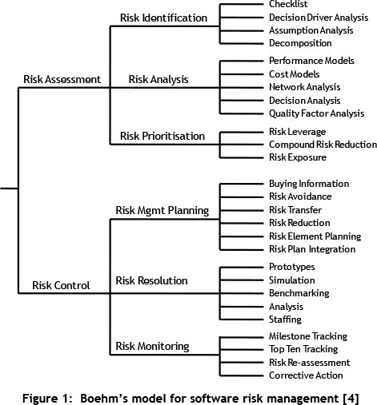
Risk Management
Risk Management
This scheme is taken from Boehm 1991, Software risk management: principles and practices.

Slide 23
Risk Assessment
Risk identification: listing project-specific risk items that are likely to compromise a project’s success. The two main approaches to the identification of risks are use of checklists and brainstorming.

Slide 24
Risk Assessment
Risk identification: listing project-specific risk items that are likely to compromise a project’s success. The two main approaches to the identification of risks are use of checklists and brainstorming.
Imagine you were a travel agent who wants to organise a trip in Scotland for foreign students during summer. What risk can you identify?

Slide 25
Top 10 Risks in Software Project Management
Personnel shortfalls
Unrealistic schedules & budgets
Developing the wrong functions and properties
Developing the wrong user interface
Gold-plating
Continuing stream of requirements changes
Shortfalls in externally supplied components
Shortfalls in externally performed tasks
Real-time performance shortfalls
Straining computer-science capabilities

Slide 26
Risk Assessment
Risk analysis: assessing the loss probability and loss magnitude for each identified risk item.

Slide 27
Risk Assessment
Risk analysis: assessing the loss probability and loss magnitude for each identified risk item.
Try to assessing the loss probability and the loss magnitude for risks identified before

Slide 28
Risk Assessment
Risk prioritisation: ordering and ranking the risk items identified and analysed.
A way is needed of distinguish the damaging and likely risks among all the one listed.

Slide 29
Risk Exposure (RE)
For each risk we can use the formula: RE = (potential damage) x (probability of occurrence)
The damage could be assessed as money value or loss in credibility of the company. This calculation assume that the damage is a constant but there are situations in which it is not, e.g. more software is created and more time would be needed to re-create it if it were lost.

Slide 30
Probability impact matrix
Another approach is to use qualitative descriptions of the possible impact and the likelihood of each risk. We can have a probability level associated with a range.
Probability impact matrix is useful when the potential damage and likelihood of a risk are defined by qualitative descriptors and so the risk exposure cannot be calculated using the previous formula

Slide 31
Probability impact matrix
Impact
High
Significant
Moderate
Low
Low
Moderate
Significant
High
Probability

Slide 32
Risk Control
Risk Management plans should be developed for each of the previous prioritized risks so that proactive action can take place. There are four categories of risks.

Slide 33
Risk Control
Risk Acceptance
Risk Avoidance
Risk Reduction / Mitigation
Risk Transfer

Slide 34
Risk Control
Risk Resolution: producing a situation in which risk items are eliminated or resolved.
Suppose we take this action, is it effective? If so how much? Have we chosen a good solution if this problem will show up?

Slide 35
Risk Control
Risk Monitoring: risks need to be revisited at regular intervals for the team to re-evaluate each risk to determine when new circumstances caused its probability and/or impact to change. At each interval, some risks may be added to the list and others taken away. Risks need to be reprioritized to see which are moved “above the line” and need to have action plans and which move “below the line” and no longer need action plans.

Slide 36
RMMM
It stands for Risk Mitigation, Monitoring and Management. Phase 4, 5 and 6 of Risk Management.
It is the organization’s responsibility to perform risk mitigation, monitoring, and management in order to produce a quality product. The quicker the risks can be identified and avoided, the smaller the chances of having to face that particular risk’s consequence. The fewer consequences suffered as a result of good RMMM plan, the better the product and the smoother the development process.

Slide 37
PERT
There are software used to evaluate risks and the effects of uncertainty.
PERT (Program Evaluation and Review Technique) is a method to analyse the involved tasks in completing a given project, especially the time needed to complete each task, and to identify the minimum time needed to complete the total project.

Slide 38
PERT
PERT was developed primarily to simplify the planning and scheduling of large and complex projects. It was able to incorporate uncertainty by making it possible to schedule a project while not knowing precisely the details and durations of all the activities. It is more of an event-oriented technique rather than start- and completion-oriented, and is used more in projects where time is the major factor rather than cost. It is applied to very large-scale, one-time, complex, non-routine infrastructure and Research and Development projects.

Slide 39
Brightmouth College
Imagine that a payroll package has been purchased. However, a new requirement emerges that the payroll database should be accessed by a new application that calculates the staff costs for each course delivered by the college. Unfortunately, the purchased payroll application does not allow this access.
This scenario could have been avoided using risk management.

Slide 40
Brightmouth College
Risk Identification
Brainstorming can be used when the project manager realises that there are aspects of college administration of which he is unaware. He therefore suggests to the main stakeholders in the project, who include staff from the finance office and the personnel office, that they meet and discuss where the risks facing the project lie.

Slide 41
Brightmouth College
Risk Identification
Actors: lack of experience running payroll.
Structure: lack of cooperation between the local authority and the college.
Tasks: evaluation of packages – software may be difficult to access to carry out evaluation testing.
Technology: existing hardware is not adequate to deal with the new application.

Slide 42
Brightmouth College
Risk Analysis and Prioritisation
Actors: lack of experience running payroll.
Someone with experience could be hired (Low)
Structure: lack of cooperation between the local authority and the college.
This is a serious problem that could take a long time (High)

Slide 43
Brightmouth College
Tasks: evaluation of packages – software may be difficult to access to carry out evaluation testing.
This is something that should be clearly stated to the supplier (Medium)
Technology: existing hardware is not adequate to deal with the new application.
Depending on how much money they have, this could be Low or High

